Slide 1
FairEval: Do Fairness Benchmarks Agree?
A cross-metric, cross-modal analysis framework for machine learning and LLM bias auditing
Abdul-Azeem Opakunle
DTSC 5505
Final Report & Presentation
Benchmarking / Evaluation
Presentation roadmap
Problem motivation and research question
Workflow, datasets, models, and metrics
Corrected benchmark results and agreement analysis
Cross-modal outputs, limitations, and next steps

Slide 2
Why this problem matters
A single fairness number can hide different harm models.
High-stakes systems can be accurate on average while distributing errors unevenly across groups.
Demographic parity, equalized odds, and predictive parity encode different normative priorities.
If the metric choice is hidden, stakeholders may treat a value-sensitive decision as an objective fact.
From one number …
… to a structured audit
Multiple
metrics
Uncertainty
“Fair”
Agreement
Documentation
Core claim: fairness auditing should be treated as a structured, multi-metric reporting task—not a one-number decision rule.

Slide 3
FairEval / DTSC 5505
Project question and contributions
Research question
What FairEval contributes
Seven classical tabular models across Adult, COMPAS, and German Credit
Three fairness metrics plus bootstrap confidence intervals
Formal agreement analysis with Kendall’s tau and Krippendorff’s alpha
Cross-modal branches for CrowS-Pairs, BBQ, and a fairness-judge workflow
Reproducible artifacts, figures, dashboard outputs, and a code package
Do fairness benchmarks agree, or do different metrics produce different judgments about which models are fairer?
3
7
3
2
3
Tabular datasets
Classical models
Core fairness metrics
Agreement statistics
Cross-modal branches
Adult · COMPAS · German Credit
LR · RF · DT · SVM · KNN · GB · GNB
DP · EO · PP
Kendall’s τ · Krippendorff’s α
CrowS-Pairs · BBQ · fairness judge
Abdul-Azeem Opakunle
3

Slide 4
FairEval / DTSC 5505
How FairEval works
Datasets
Preprocessing
Models
Metrics &
Agreement
Artifacts /
Dashboard
Validate dataset schemas and sensitive-attribute fields at ingestion time.
Preprocess features while preserving the sensitive attribute for downstream auditing.
Train multiple model families under a consistent benchmark protocol.
Compute accuracy, fairness metrics, and inter-metric agreement statistics.
Write results, figures, and dashboard artifacts from the same output directory.
Design goals
Traceable results rather than one-off experiments
A workflow in which every major claim maps to a saved artifact
Consistent reporting across the report, dashboard, README, and code package
Why this structure matters
The same output directory feeds the report, plots, and dashboard. That makes the project easier to verify and much easier to defend in the code walkthrough.
Abdul-Azeem Opakunle
4

Slide 5
FairEval / DTSC 5505
Data, models, and metrics
Datasets
Model families
Fairness + agreement
Adult
Logistic regression as an interpretable linear baseline
Random forest and decision tree for nonlinear tabular rules
SVM, KNN, gradient boosting, and Gaussian naive Bayes for broader model diversity
DP
EO
PP
Income classification
sex
Outcome
parity
Error
parity
Meaning
parity
COMPAS
Agreement layer
Two-year recidivism
race
Kendall’s τ captures rank agreement among metrics.
Krippendorff’s α summarizes whether metrics behave like near-redundant raters.
German Credit
Credit risk
personal status / sex proxy
The goal is not just to report fairness scores—it is to report how stable the fairness story is.
Why this setup is useful
Three domains: income, criminal justice, and credit risk
Seven classical models spanning linear, tree-based, distance-based, margin-based, and probabilistic families
Abdul-Azeem Opakunle
5

Slide 6
FairEval / DTSC 5505
A critical revision: correcting the Adult fairness bug
What went wrong in the earlier milestone?
Before
After
The local Adult CSV stored the sensitive field as “sex:” rather than “sex.”
The old preprocessing path missed that field and collapsed records into a fallback group.
Adult fairness metrics were therefore forced to zero across every model.
Adult disparities
= 0.000
for every
model
Adult now shows non-zero
DP, EO, and PP
across all seven models
Why the fix matters
Bottom line: debugging the data pipeline changed the scientific interpretation.
The corrected rerun restores non-zero Adult disparities for all seven models.
This makes the benchmark more credible because reproducibility checks are part of the audit itself.
Abdul-Azeem Opakunle
6

Slide 7
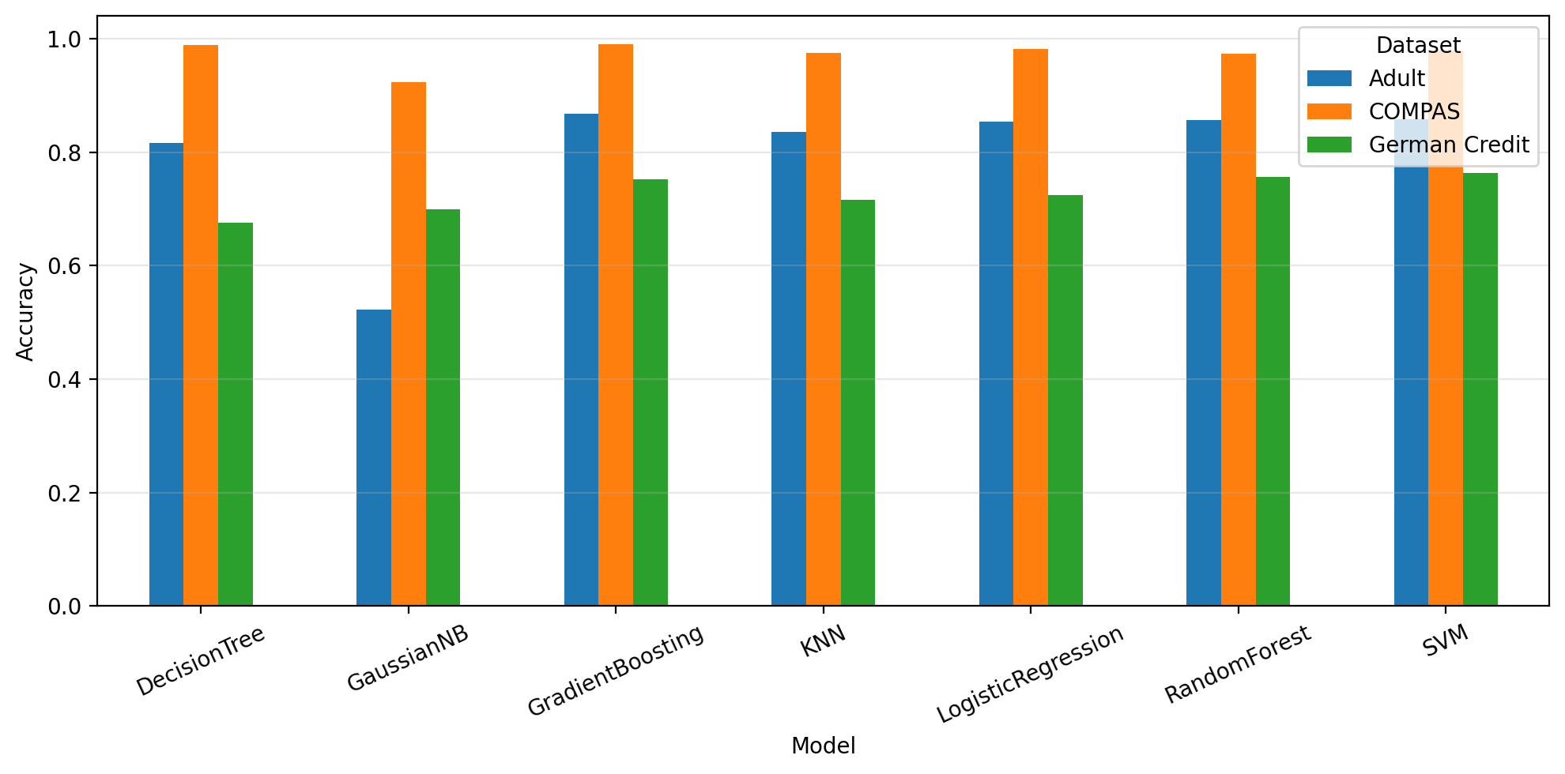
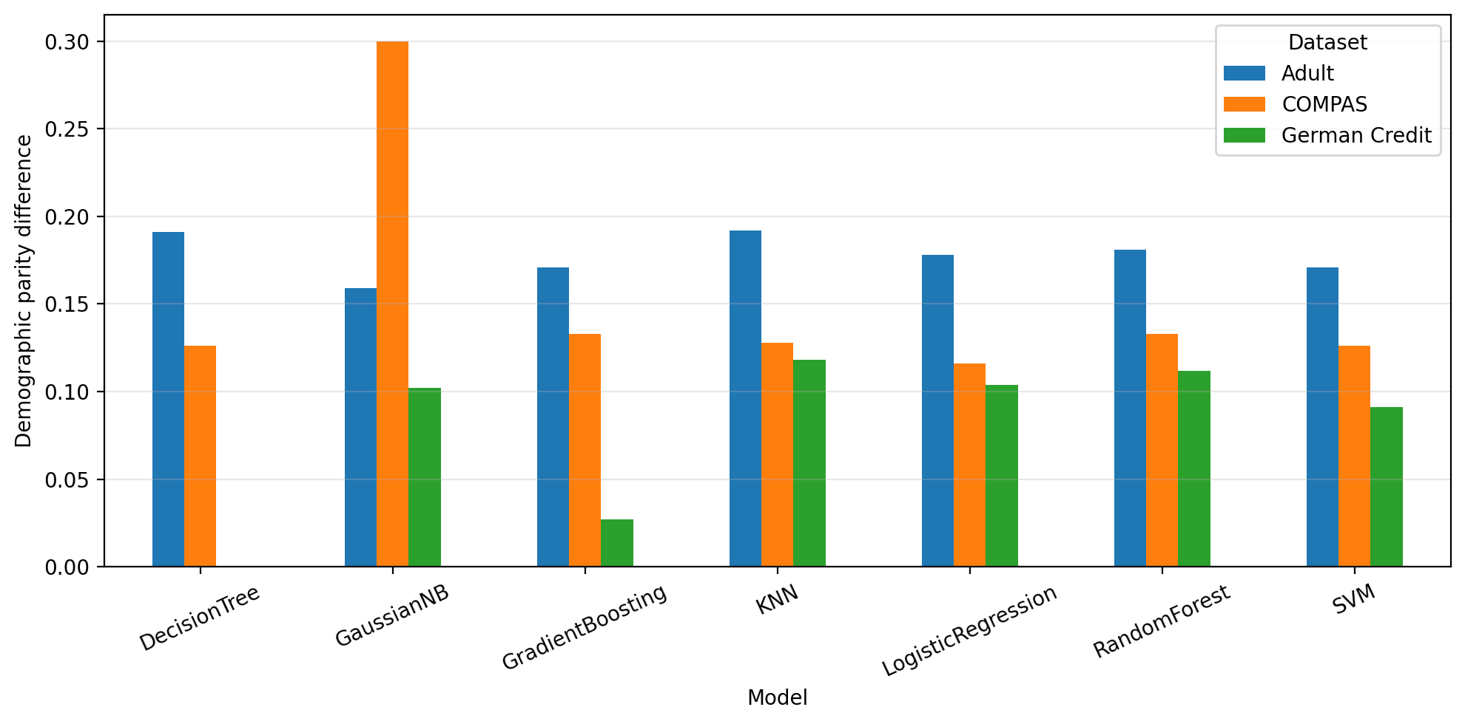
FairEval / DTSC 5505
Corrected benchmark results: performance and disparities
Takeaway: predictive performance varies across datasets, and fairness disparities remain non-zero after the Adult correction. The “best” model depends on whether you prioritize utility, selection-rate parity, or error parity.
Abdul-Azeem Opakunle
7

Slide 8
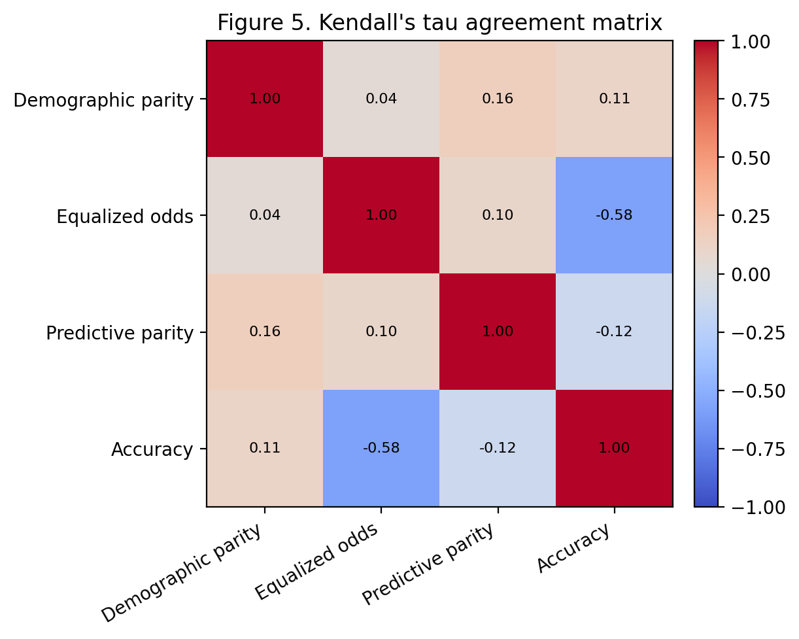
FairEval / DTSC 5505
What the corrected results mean
Dataset-level findings
Adult
No model is disparity-free after the correction. Gradient boosting is strongest on accuracy, but not every metric tells the same story.
COMPAS
Several models are highly accurate, yet the fairness picture is still nontrivial. Strong predictive performance does not settle the fairness ranking.
German Credit
The benchmark is smaller and noisier, which makes the intervals and comparisons more important. A zero value on one metric does not imply broad fairness.
Agreement is partial, not complete. Equalized odds and accuracy are moderately negatively associated (τ ≈ -0.58).
Abdul-Azeem Opakunle
8

Slide 9
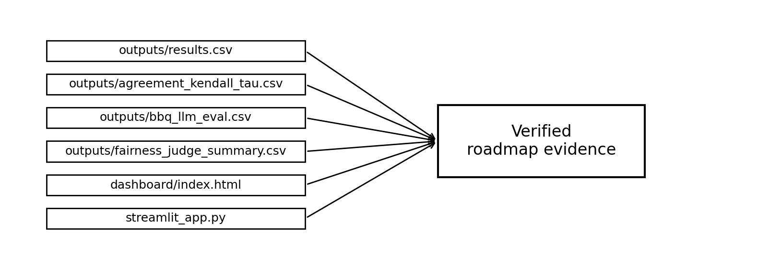
FairEval / DTSC 5505
Cross-modal outputs and reproducibility evidence
0.940
0.805
1.000
Why this matters
CrowS-Pairs
BBQ
Fairness judge
Saved output accuracy over 50 evaluated sentence-pair judgments
Saved output accuracy over 200 benchmark items
Benchmark–judge agreement in the saved summary artifact
The package does more than produce tabular results once; it preserves outputs, a dashboard path, and audit-ready artifacts.
Named files make the roadmap claims easy to check.
The report, dashboard, README, code package, and walkthrough all point to the same saved evidence.
That makes the final submission easier to defend during both the presentation and the code demo.
Abdul-Azeem Opakunle
9

Slide 10
FairEval / DTSC 5505
Limitations, future work, and final takeaways
Key limitations
Final takeaways
Sensitive-attribute choices remain simplified and are not fully intersectional.
Agreement is computed over a limited set of datasets, model families, and threshold choices.
Public fairness benchmarks are informative, but they are not substitutes for deployment-specific audits.
Language branches such as CrowS-Pairs and BBQ capture only part of the broader social-harm landscape.
Report fairness as a structured multi-metric audit, not a single score.
The corrected Adult rerun shows why reproducibility and code inspection matter.
Partial agreement among metrics is exactly why agreement analysis belongs in the workflow.
The final package combines tabular benchmarking, cross-modal branches, saved artifacts, and a dashboard.
High-value next steps
Add threshold sweeps and richer fairness–utility trade-off visualizations.
Expose more fairness confidence intervals directly in the report and dashboard.
Expand the fairness-judge rubric and compare against newer toolkits such as LangFair and FairBench.
Thank you
Abdul-Azeem Opakunle
DTSC 5505
Questions?
Abdul-Azeem Opakunle
10

